Slide 1
Handling data within a program
What is a variable? | A value that can change
What is a datatype? | A type of data
Datatype (Identify) | Examples (Drag the examples around this slide next to the correct datatype) | Describe the purpose of the datatype
String |  | To store more than one character.
Character |  | To store a single character (letter or symbol)
Date/time |  | To store the date and/or time
Integer |  | To store whole numbers
Floating Point / Real |  | To store decimal numbers
Boolean |  | To store a true or false value
Arrays & Sets (strictly speaking this is a data structure) |  | To store more than 1 character in a specific order, all of which have their own individual value.
“Distinction”
“Grade A”
0161 280 8280
‘C’
‘A’
‘@’
18/12/2019 16:32
10/02/2020
20
-57
0
1.79
0.25
-79.99
false
true
{ 1, 2, 3, 4, 5, 6 }
{ ‘A’, ‘B’, ‘C’, ‘D’}
Explain why it is important for programmers to use variable identifiers and datatypes effectively? | To improve efficiency and to make it easier to read.

Slide 2
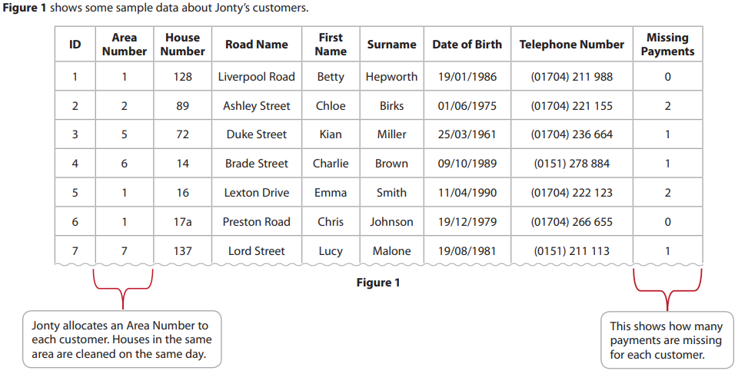

Bronze 1
Exam Questions
Write the 3 reasons below [3 marks]
Because it is too long Because it starts with ‘0’ Because it will never be changed or appended to

Slide 3
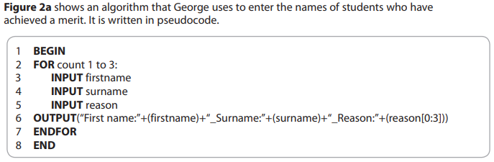
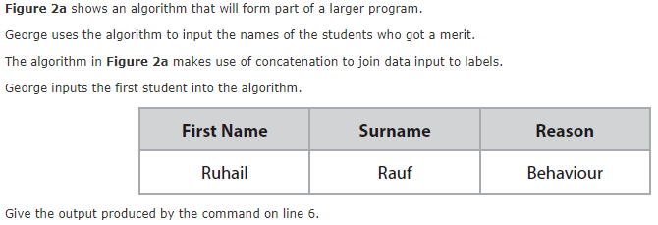
Bronze 2
Exam Questions
Write the output in the space below [3 marks]
Firstname:Ruhail_Surname:Rauf_Reason:Beh

Slide 4
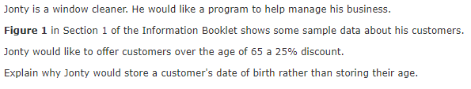
Bronze 3
Exam Questions
Explain below[2 marks]
Because their age can change and having their birth date allows him to calculate when it changes and keep up to date.

Slide 5
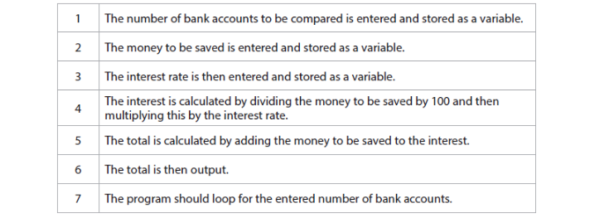
Silver 1
Exam Questions
Explain below[3 marks]

Slide 6
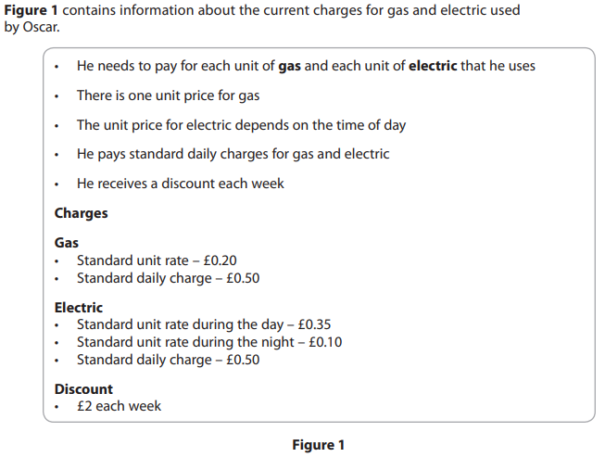

Silver 2
Exam Questions
Explain below[3 marks]

Slide 7
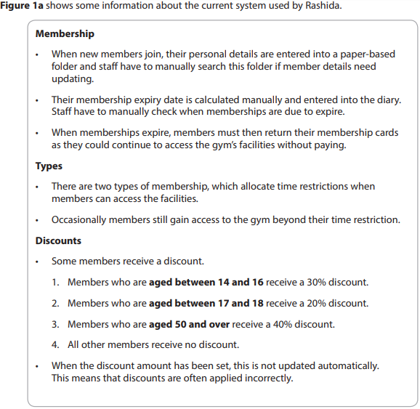
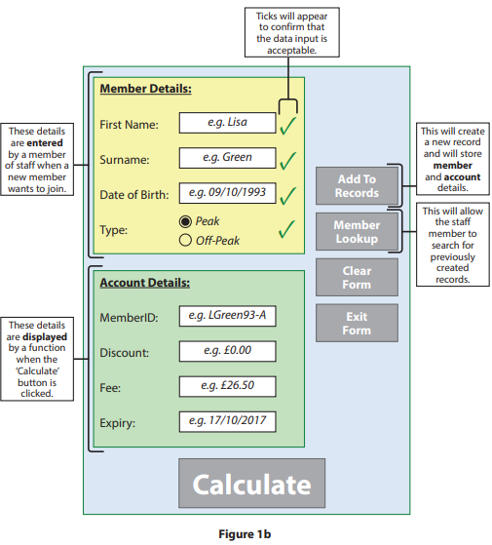
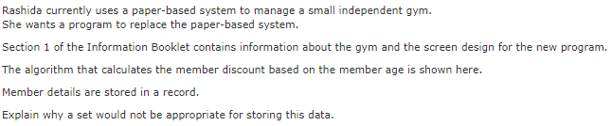
Silver 3
Exam Questions
Explain below[3 marks]

Slide 8
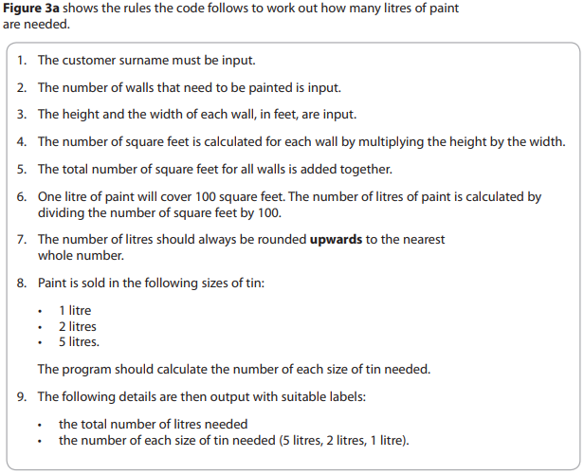
Gold 1
Exam Questions

Slide 9
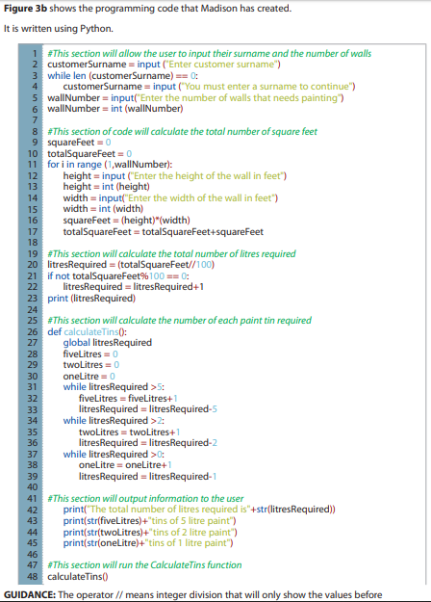
Gold 1
Exam Questions

Slide 10
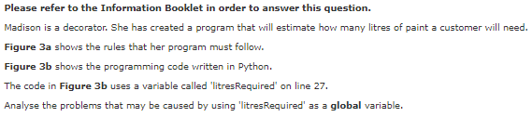
Gold 1
Exam Questions
Analyse below[6 marks]

Slide 11
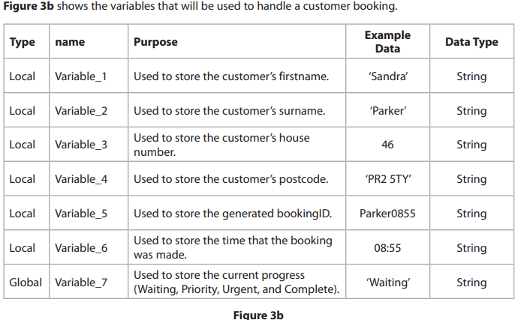
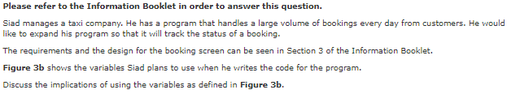
Gold 2
Exam Questions
Discuss below [10 marks]

